Slide 1
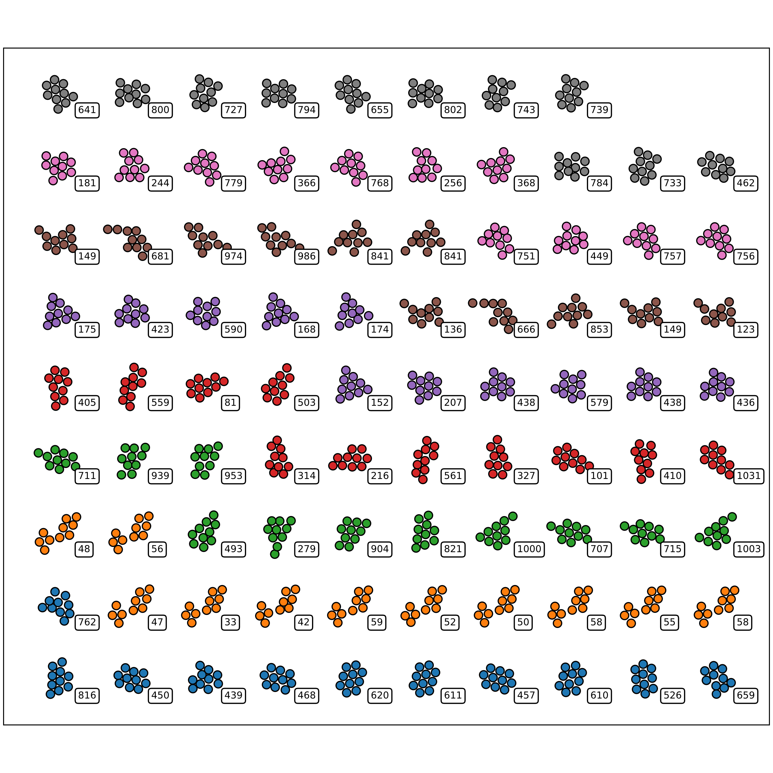
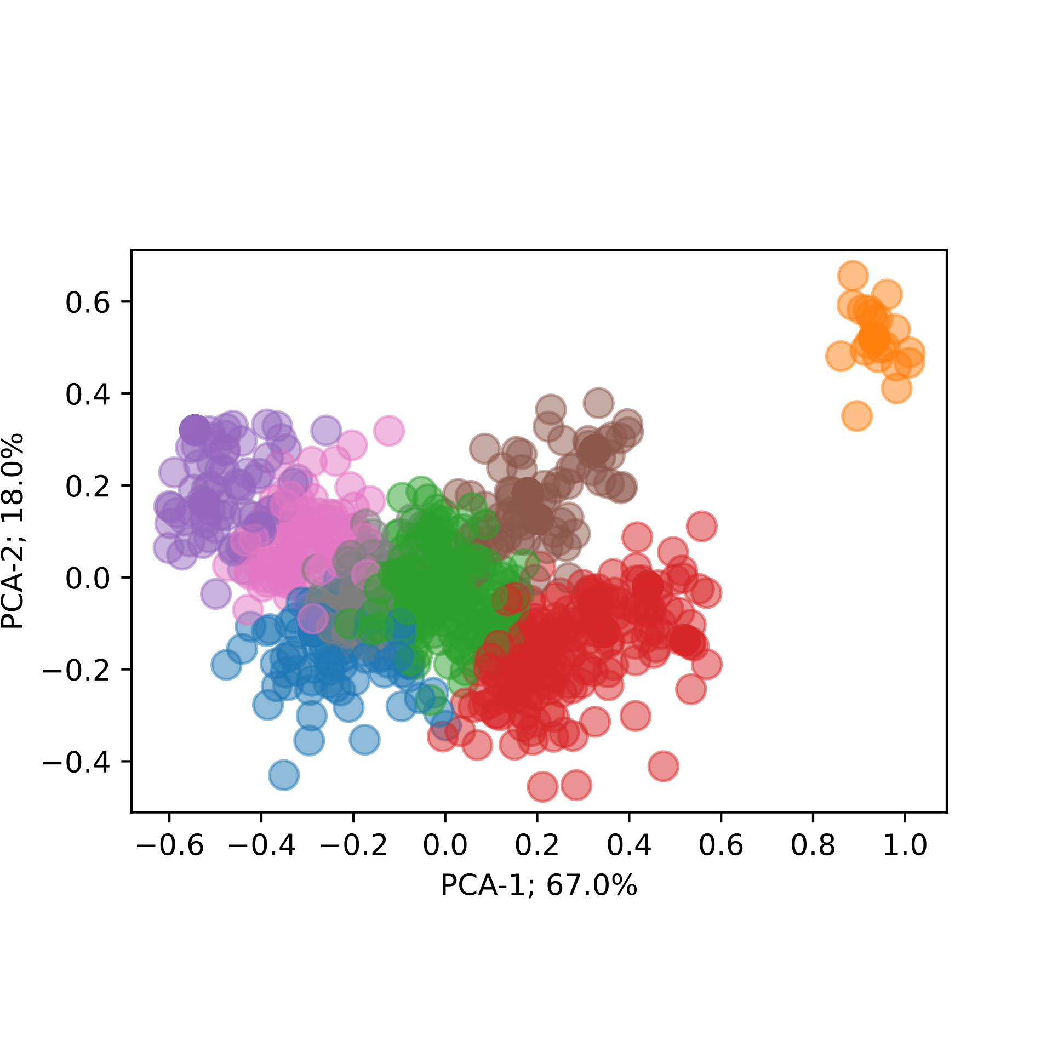
Clustering & Classification

Slide 2
Introduction to clustering & classification
Goal: Understand clustering & classification
Go through examples: We want to classify atoms according to energy
We need a ”finger-print” of data → Descriptors
Need to obey certain symmetries
Having found descriptor → How do we then classify?
Helpful tool: Principal Component analysis (PCA)
Two strategies: Supervised- vs. Unsupervised learning.
Cross-entropy

Slide 3
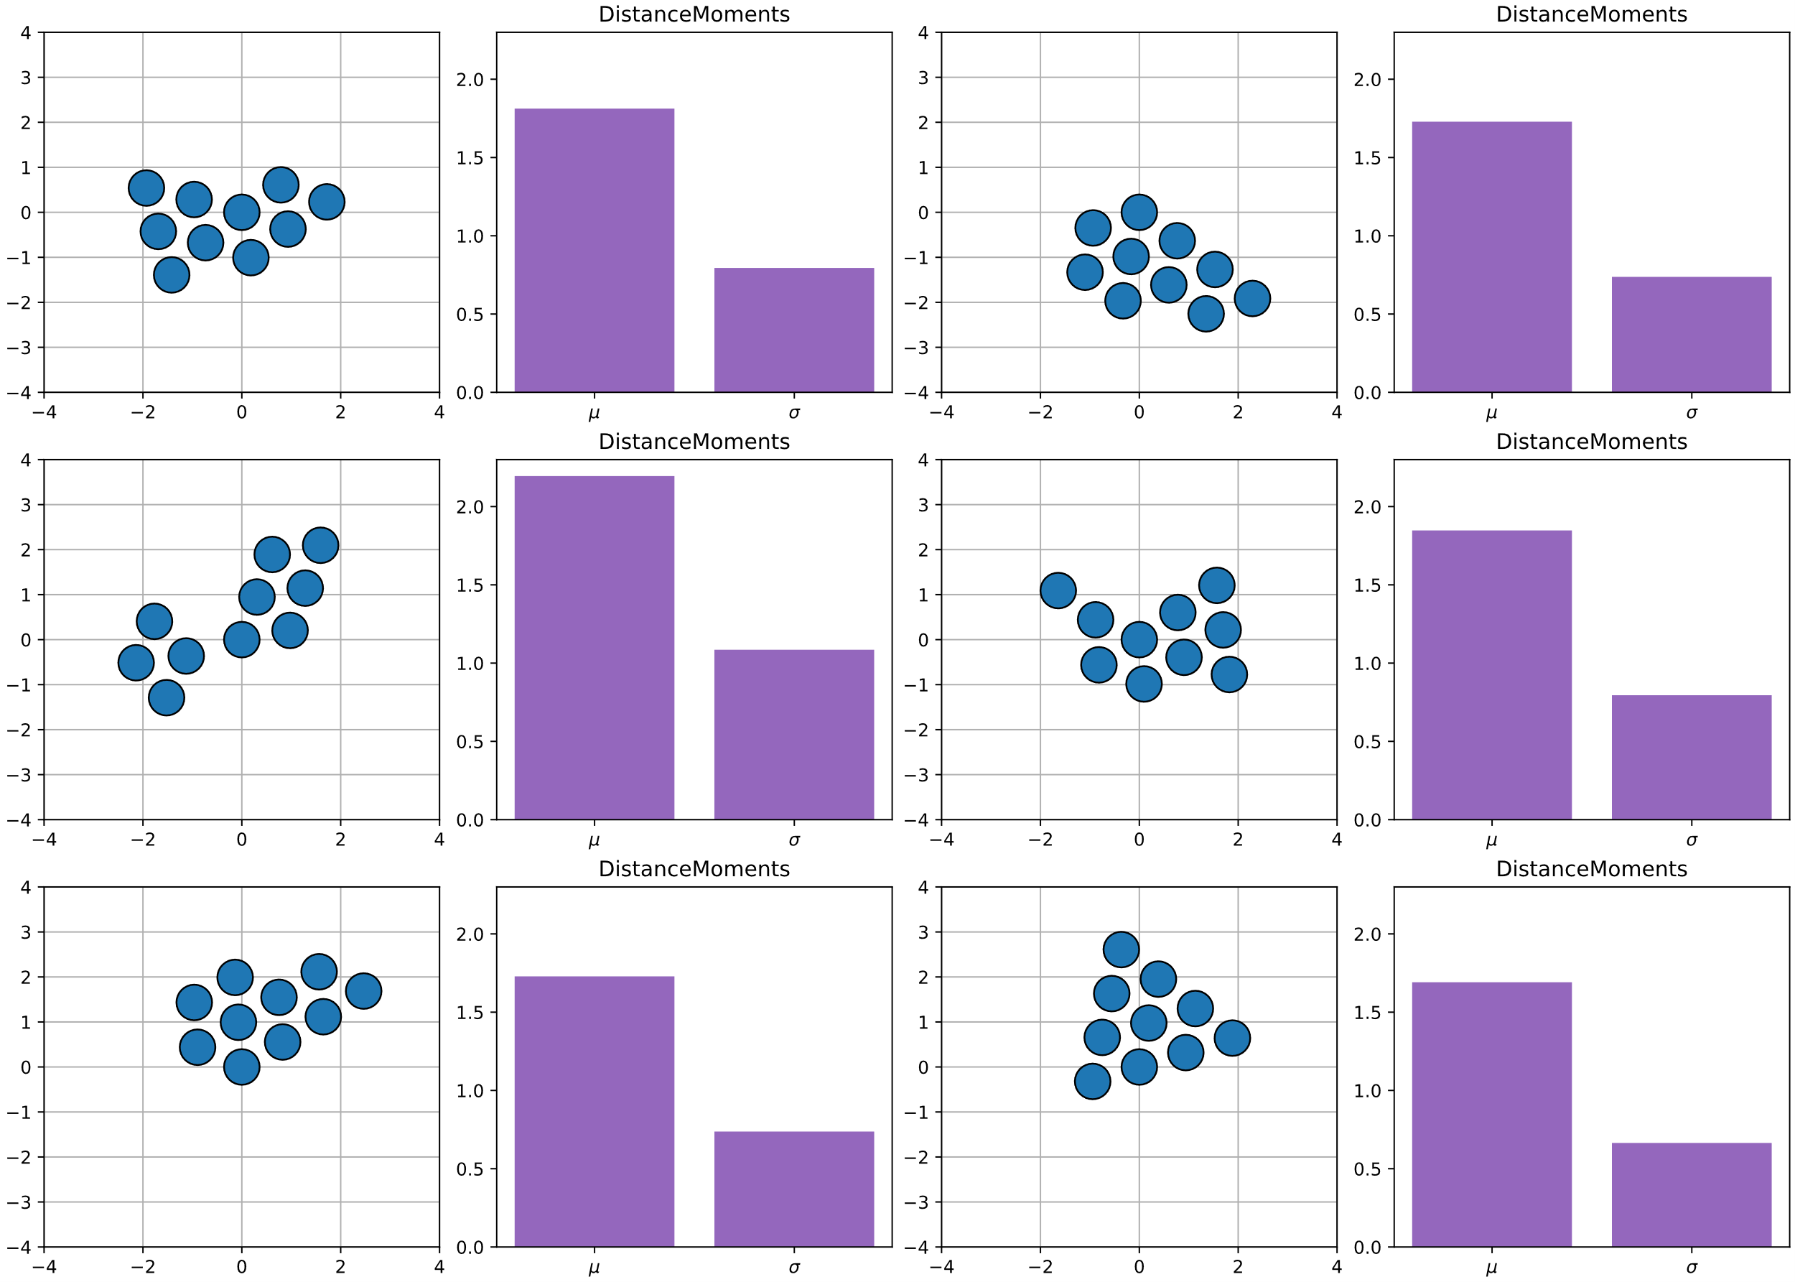
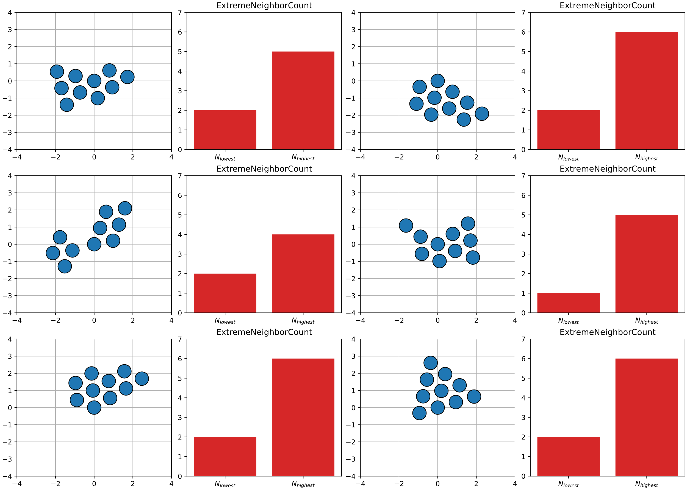
Distance Moments & Extreme neighbor counting

Slide 4
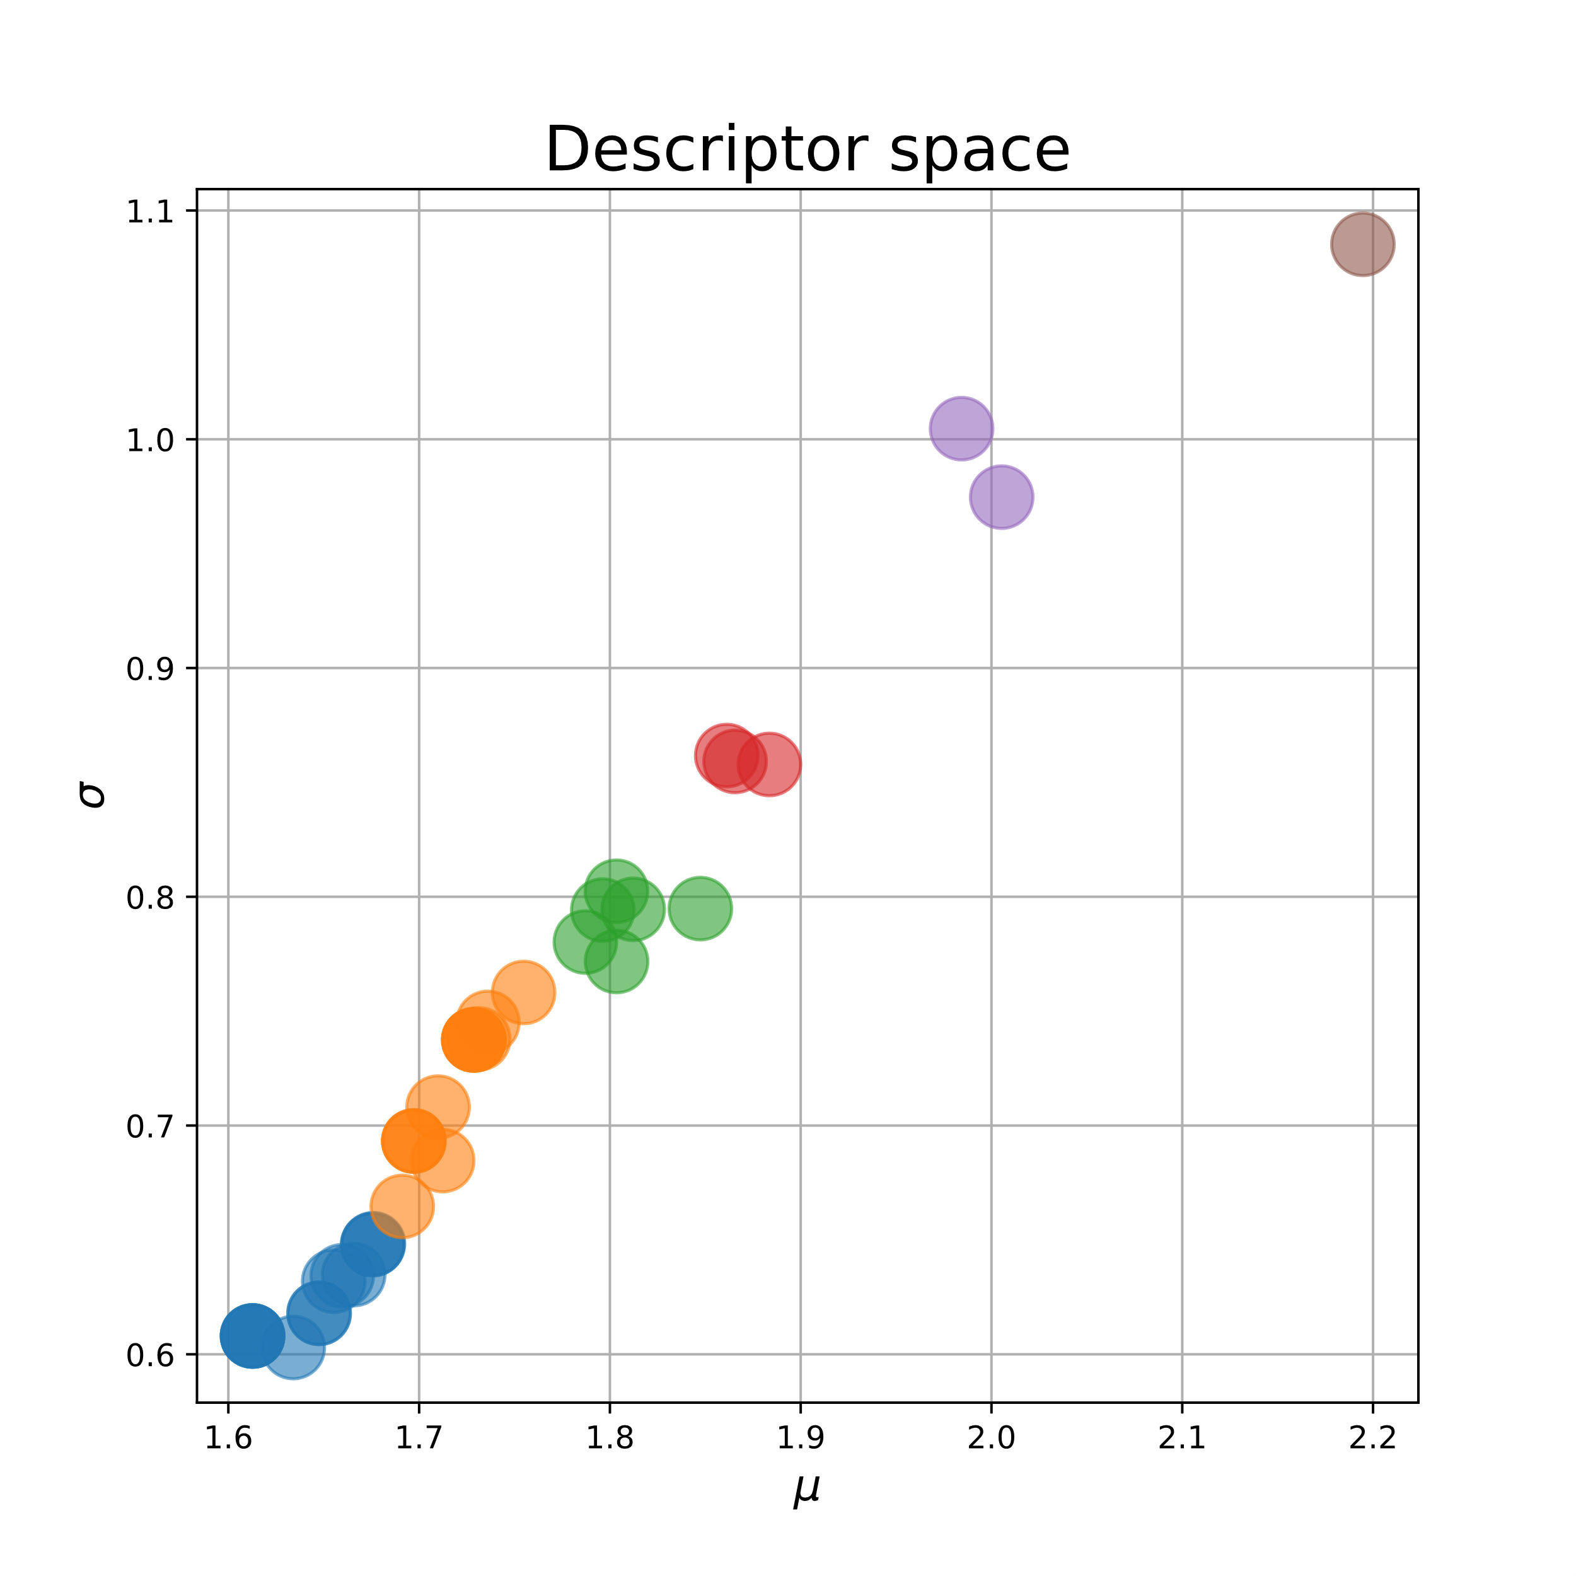
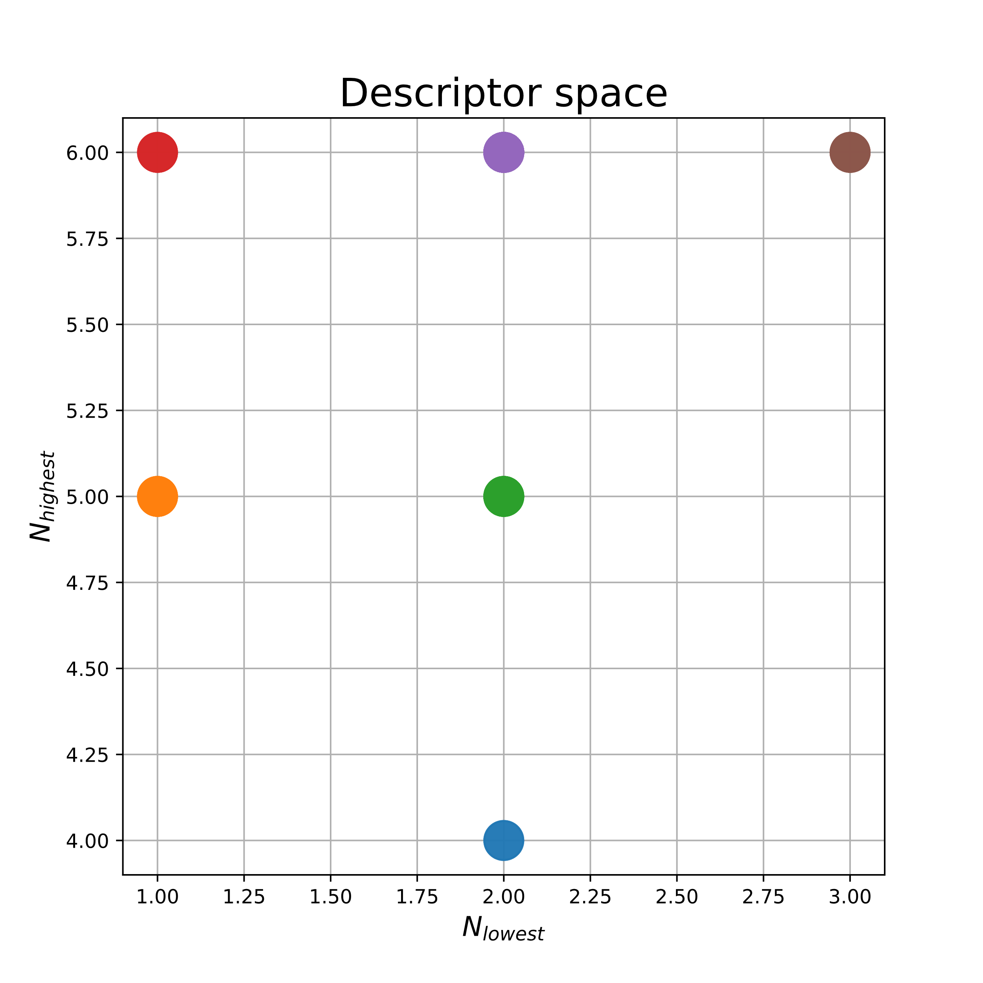
Distance Moments & Extreme neighbor counting

Slide 5
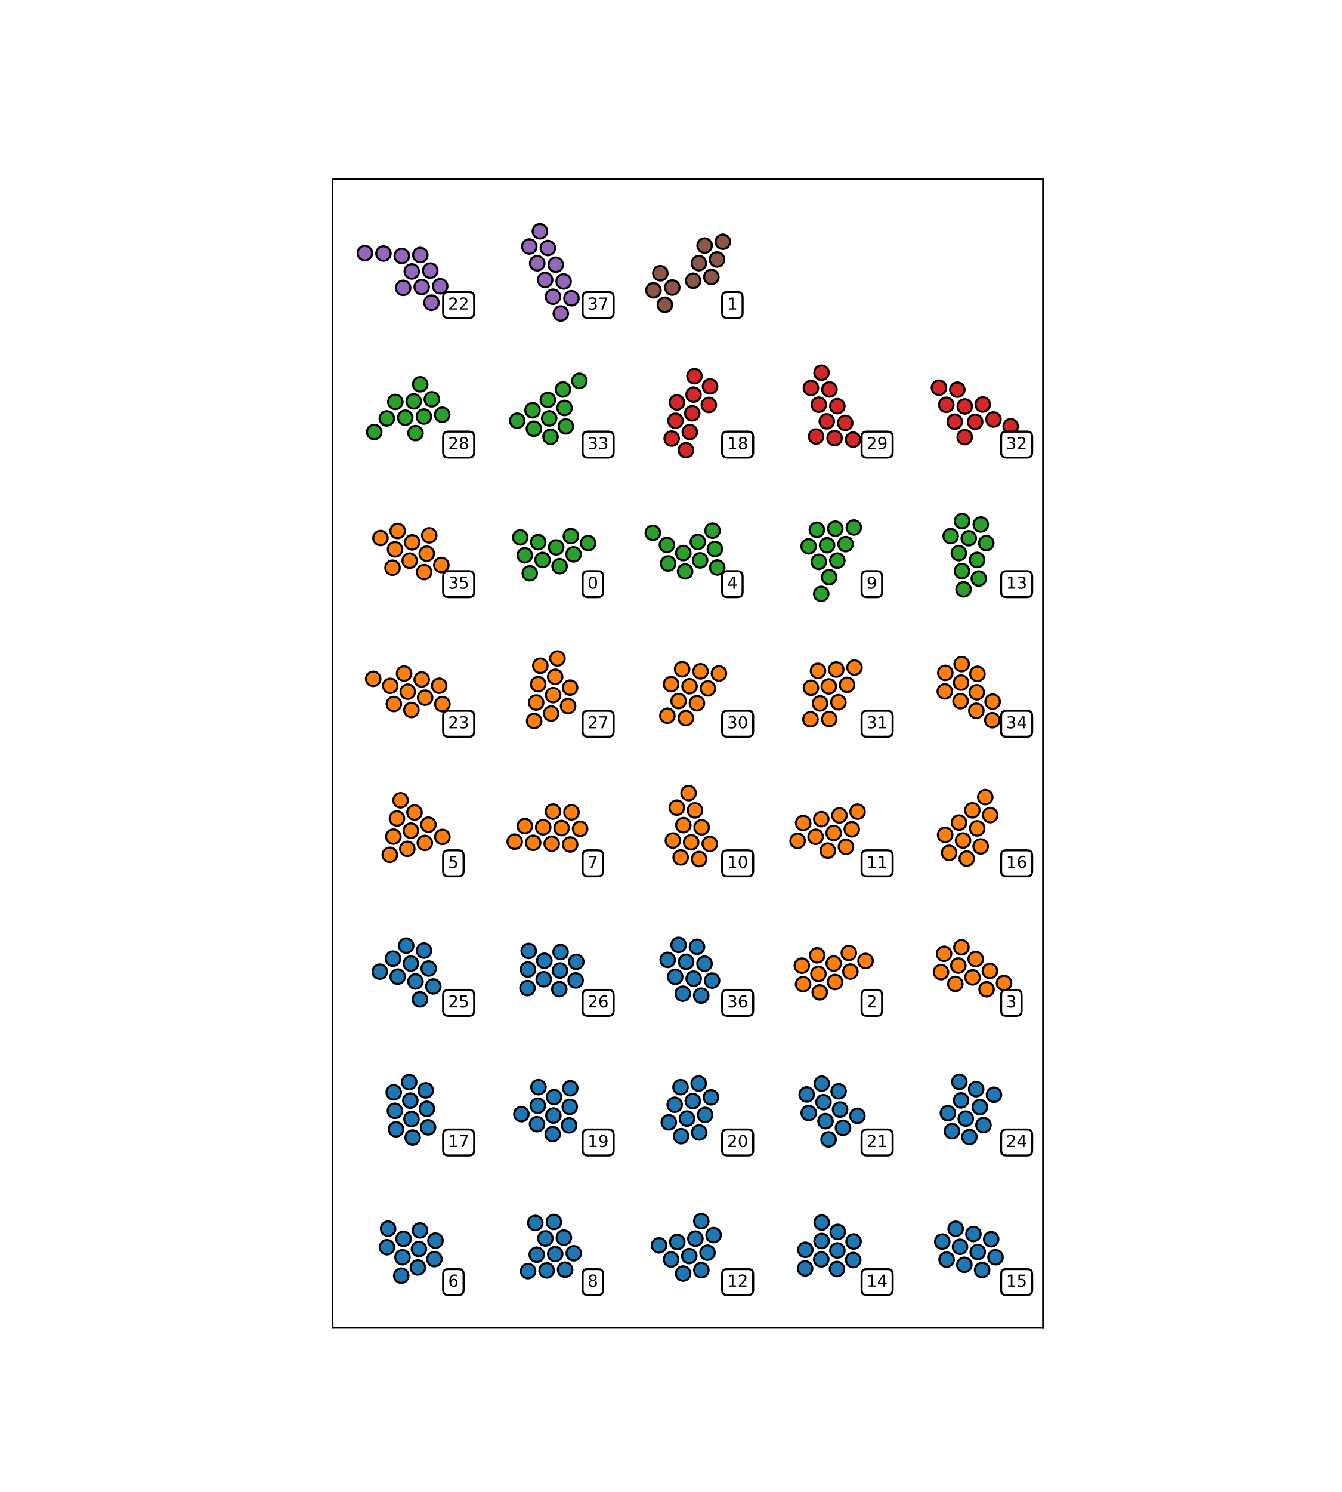
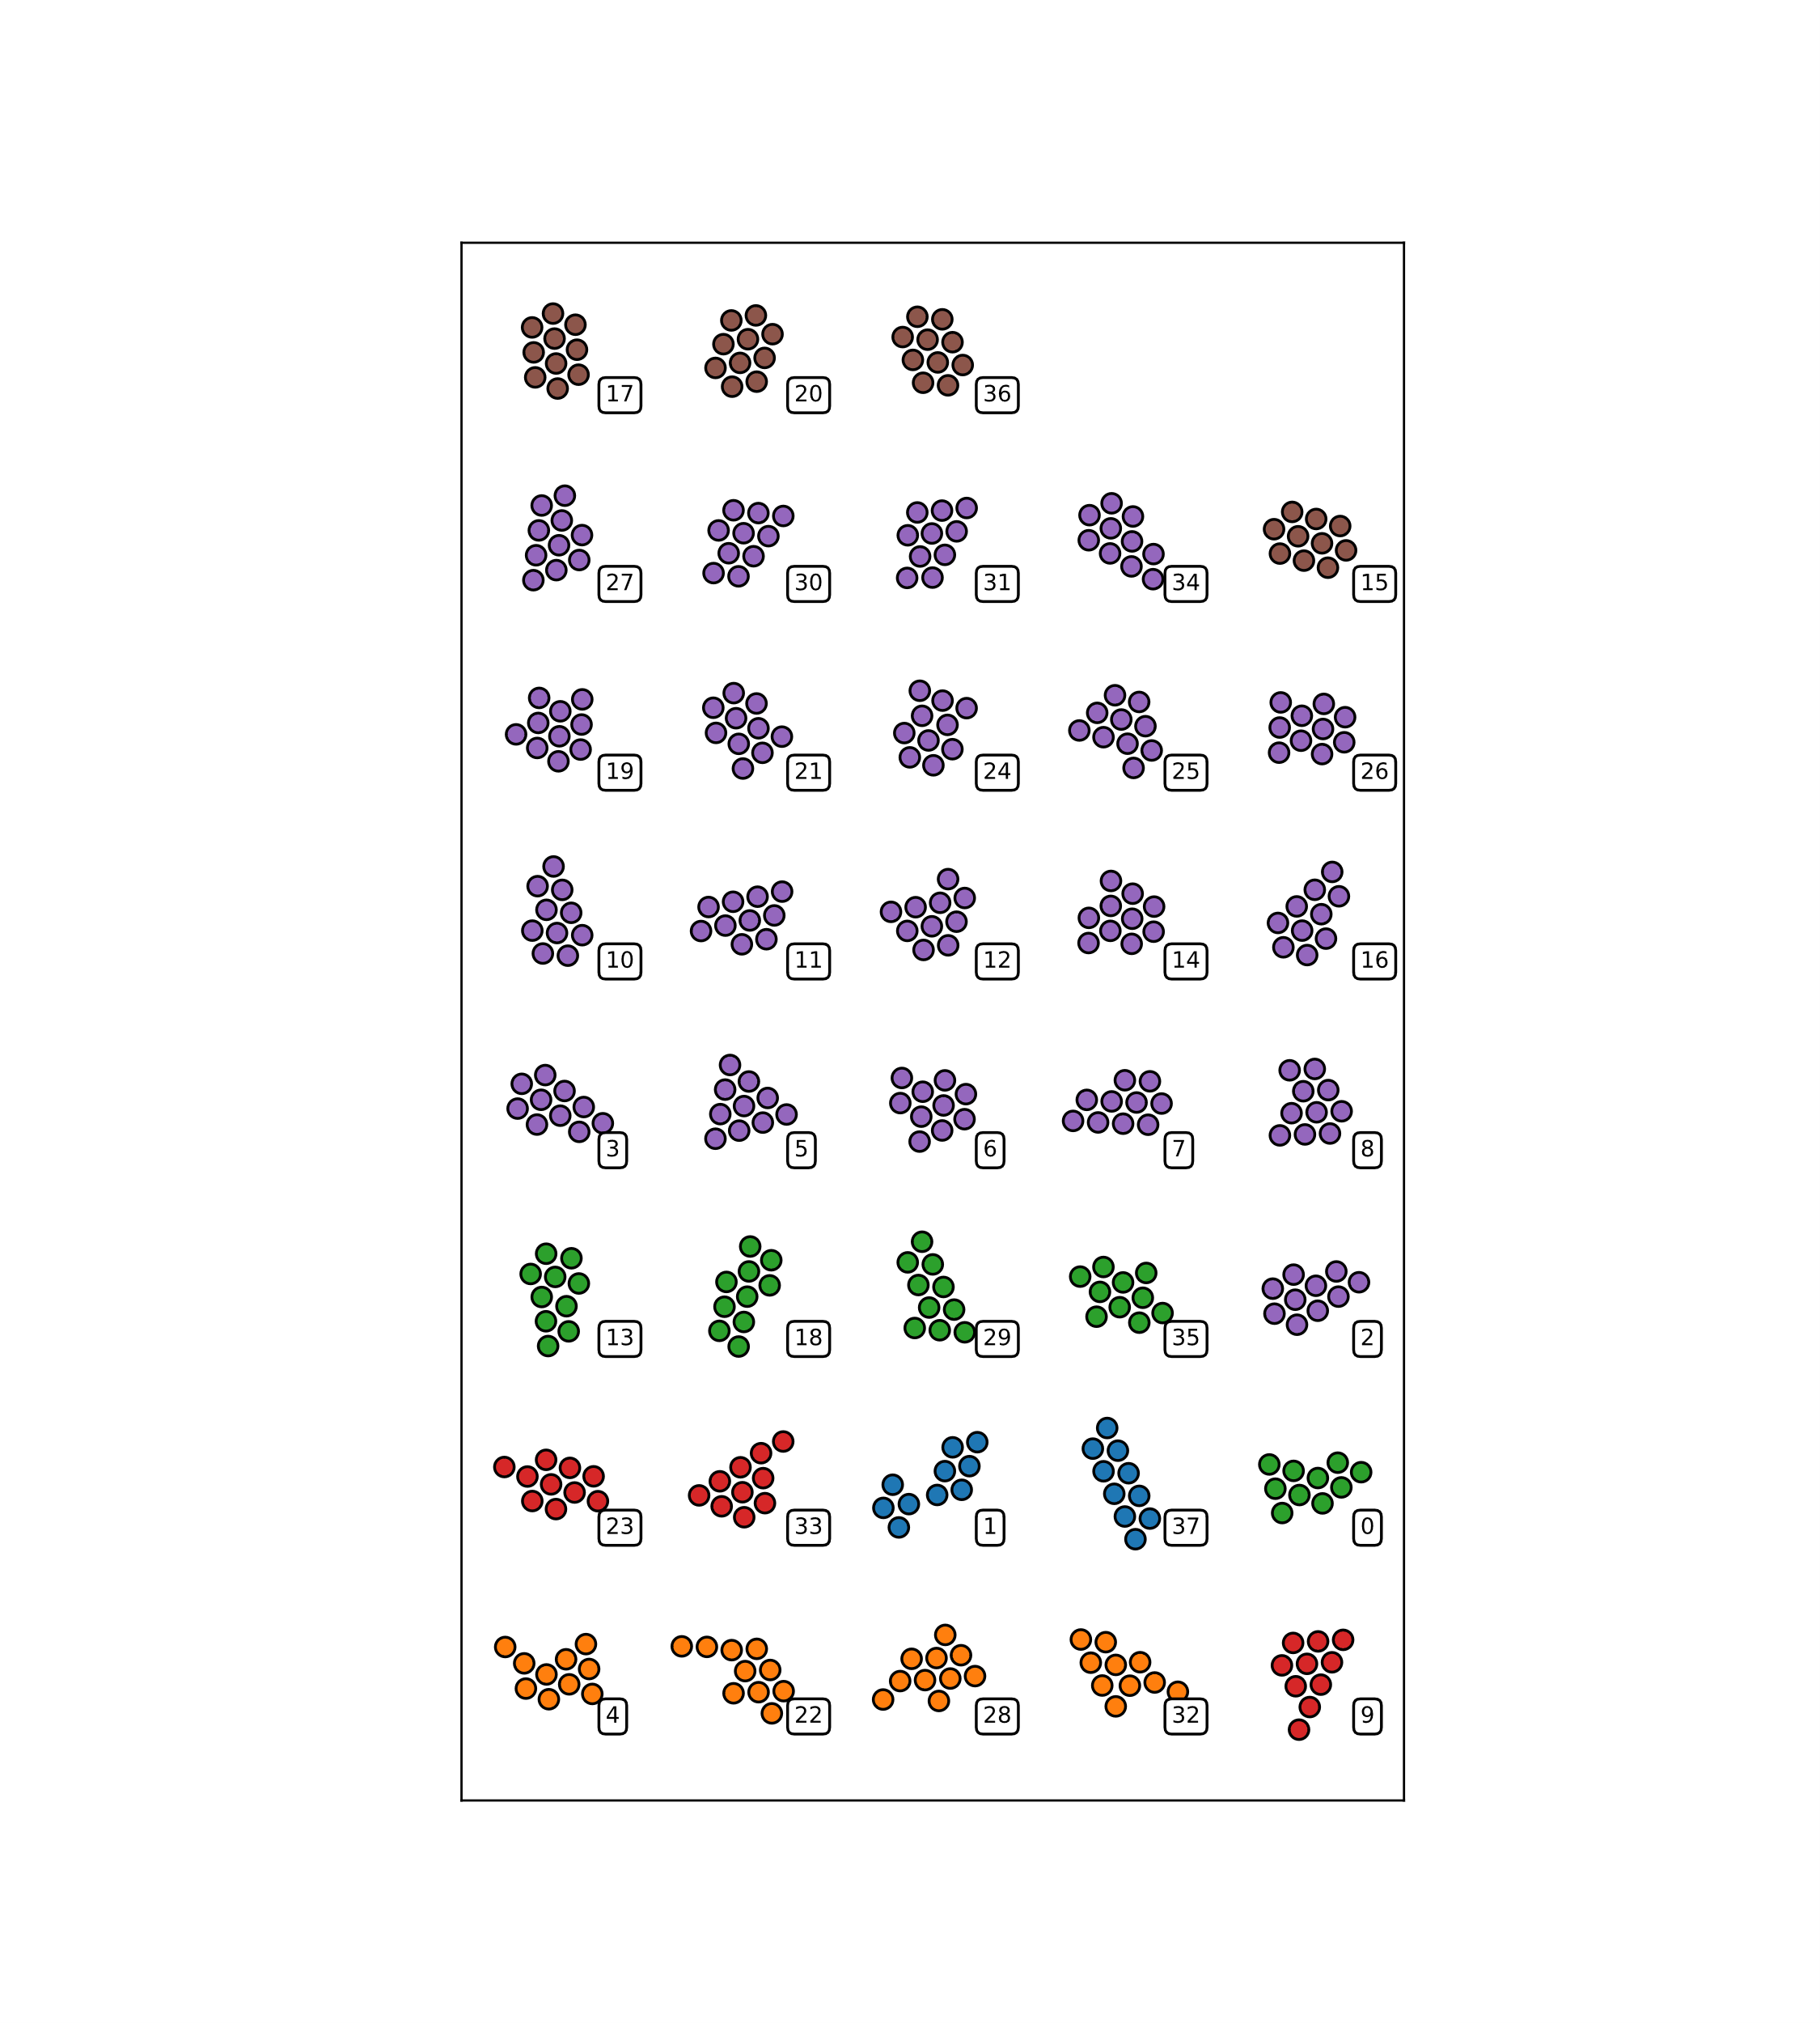
Distance Moments & Extreme neighbor counting

Slide 6
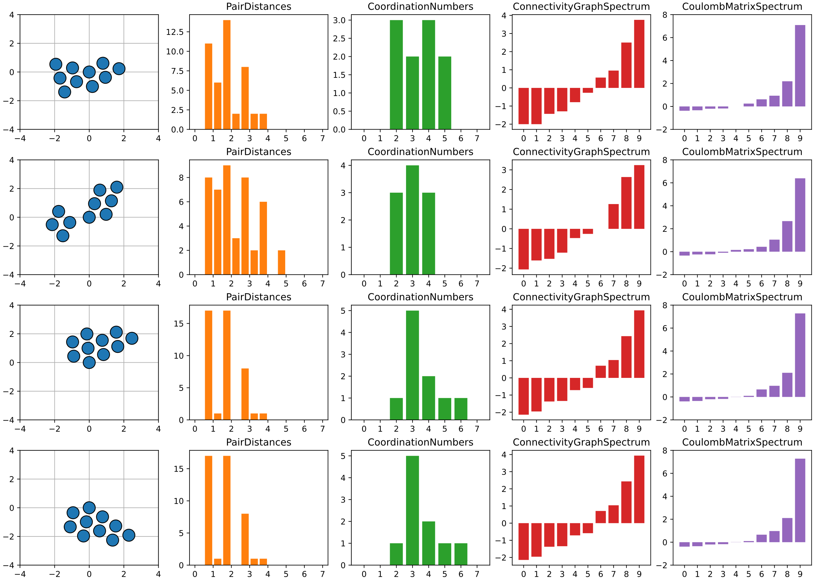
More ”expressive” descriptors
All are global descriptors

Slide 7
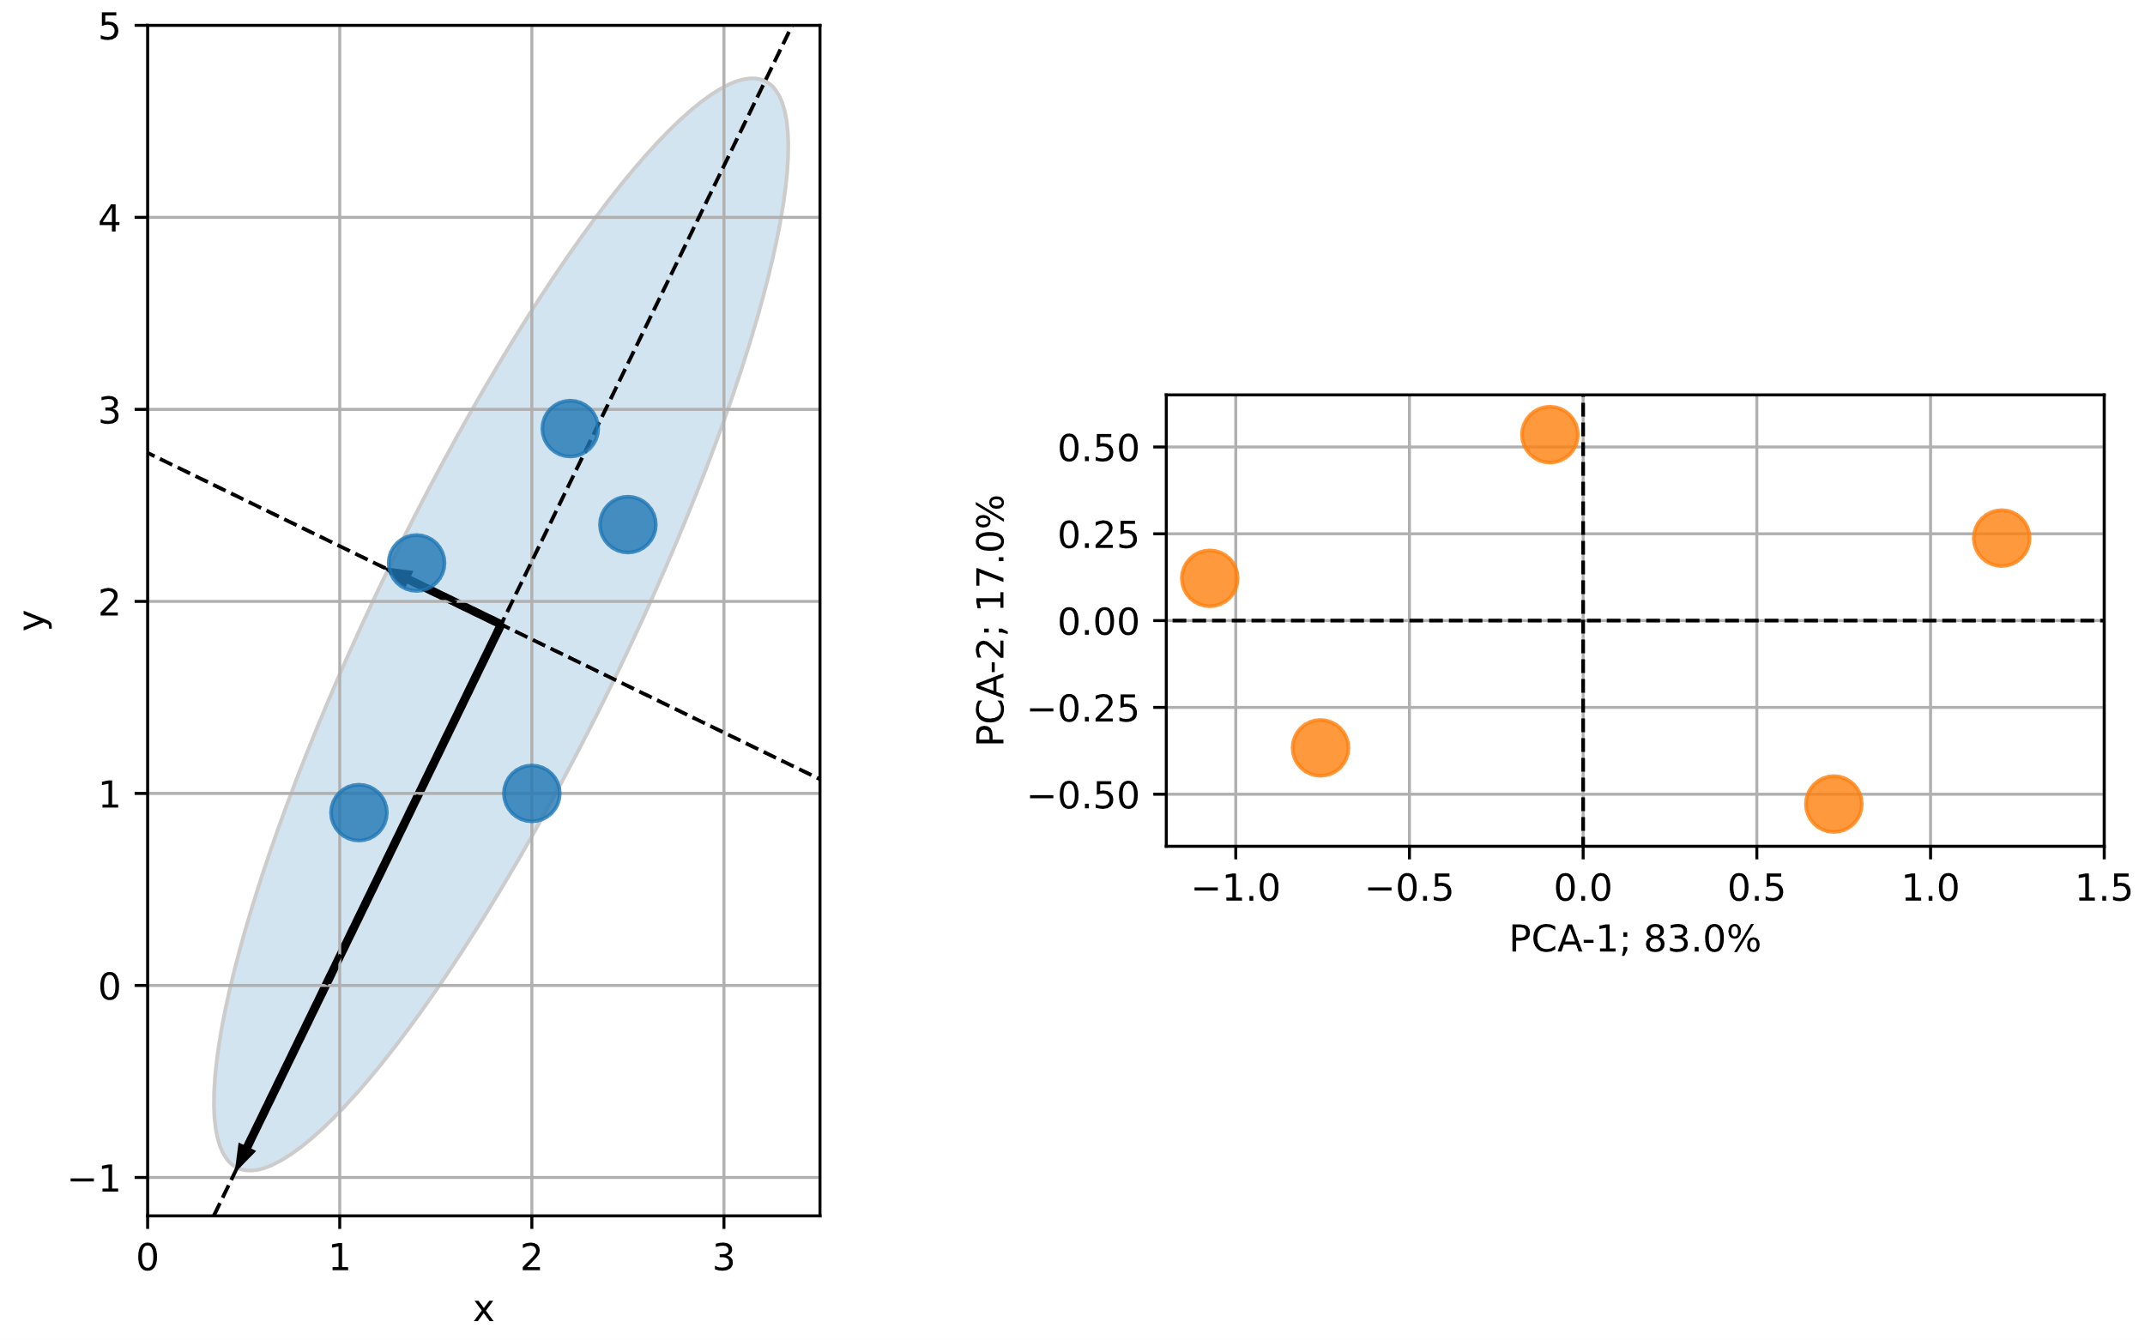
Principal component analysis (PCA)
Continuing with Coulomb spectrum.
We can no longer plot descriptors as before.
Luckily, we have PCA
Find covariance matrix
Find eigenvectors → Sort

Slide 8
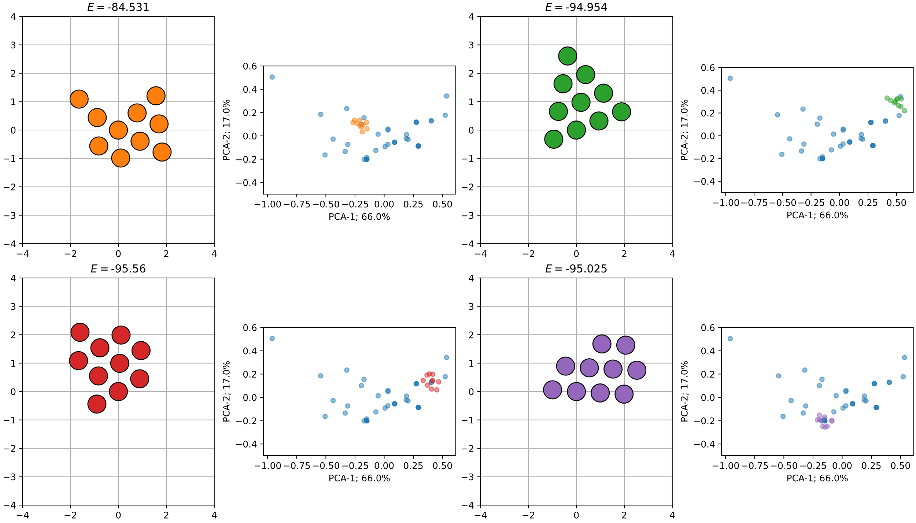
Principal component analysis (PCA)

Slide 9
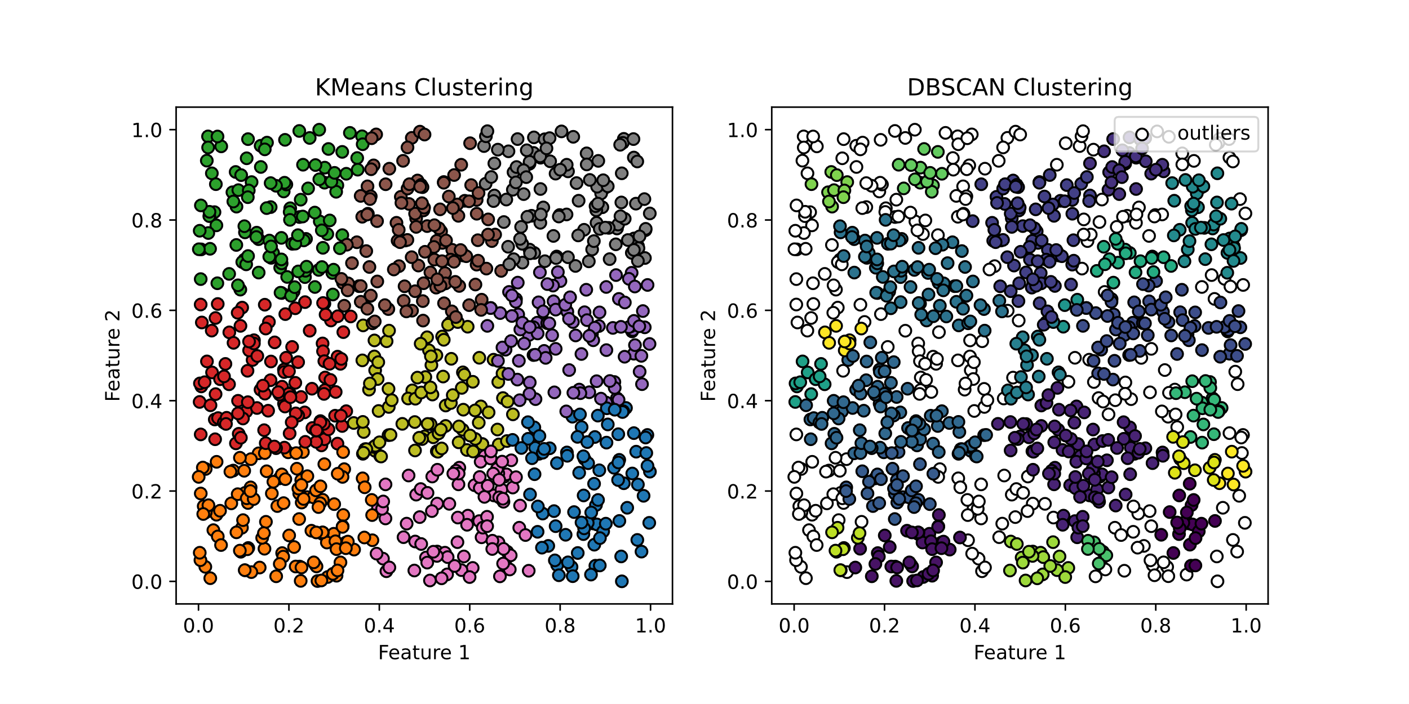
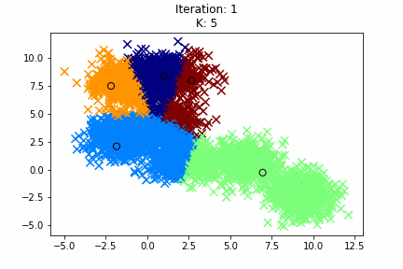
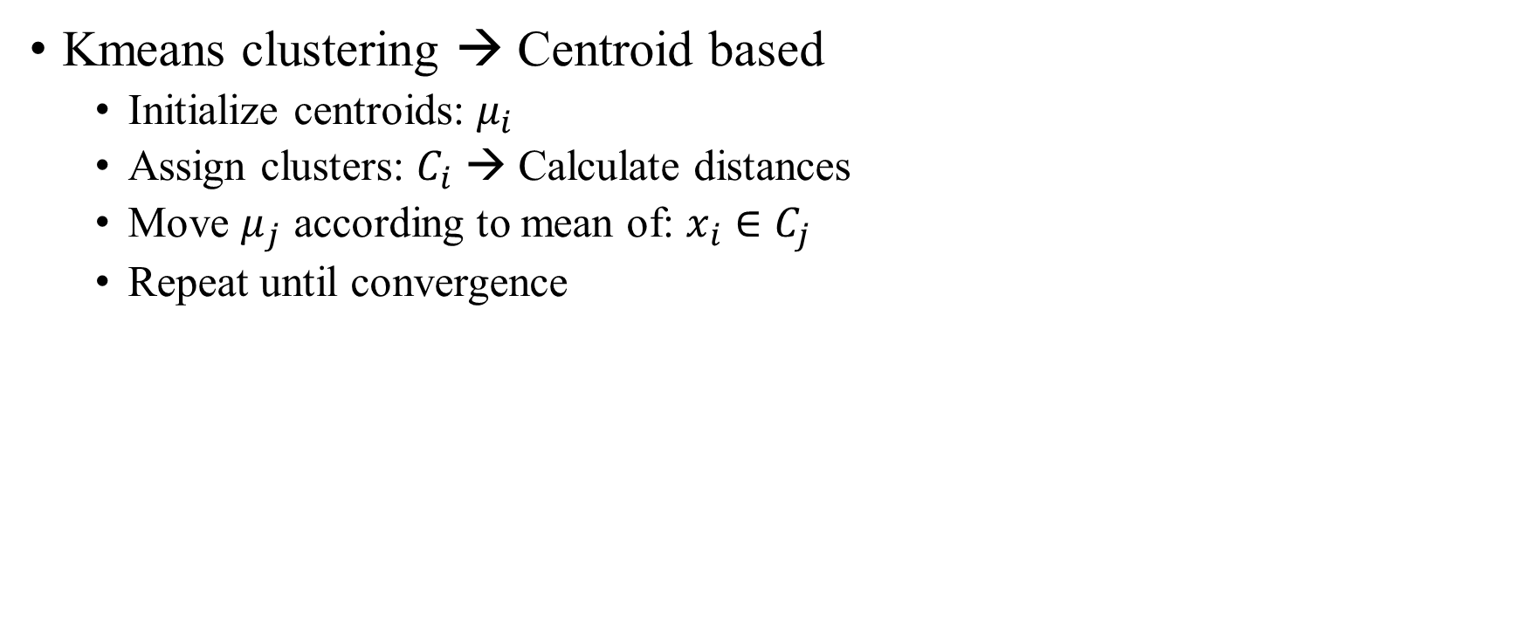
Unsupervised machine learning methods
Kmeans clustering → Centroid based
Initialize centroids: $μ_{i}$
Assign clusters: $C_{i}$ → Calculate distances
Move $μ_{j}$ according to mean of: $x_{i}∈C_{j}$
Repeat until convergence

Slide 10
Unsupervised machine learning methods
Kmeans clustering → Centroid based
Initialize centroids: $μ_{i}$
Assign clusters: $C_{i}$ → Calculate distances
Move $μ_{j}$ according to mean of: $x_{i}∈C_{j}$
Repeat until convergence

Slide 11
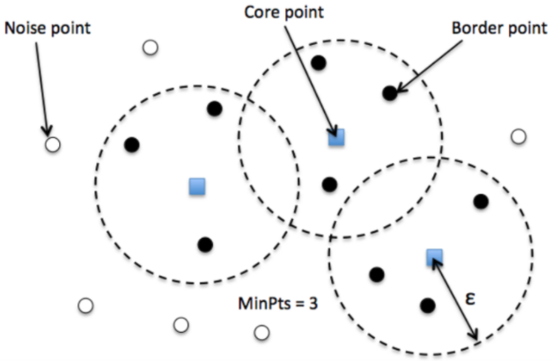
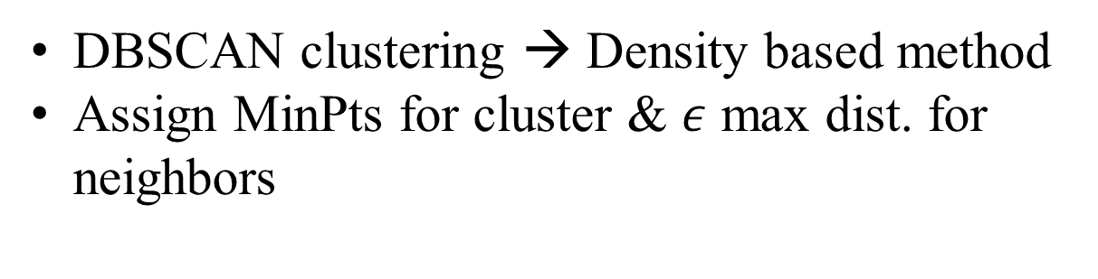
Unsupervised machine learning methods
DBSCAN clustering → Density based method
Assign MinPts for cluster & $ε$ max dist. for neighbors

Slide 12
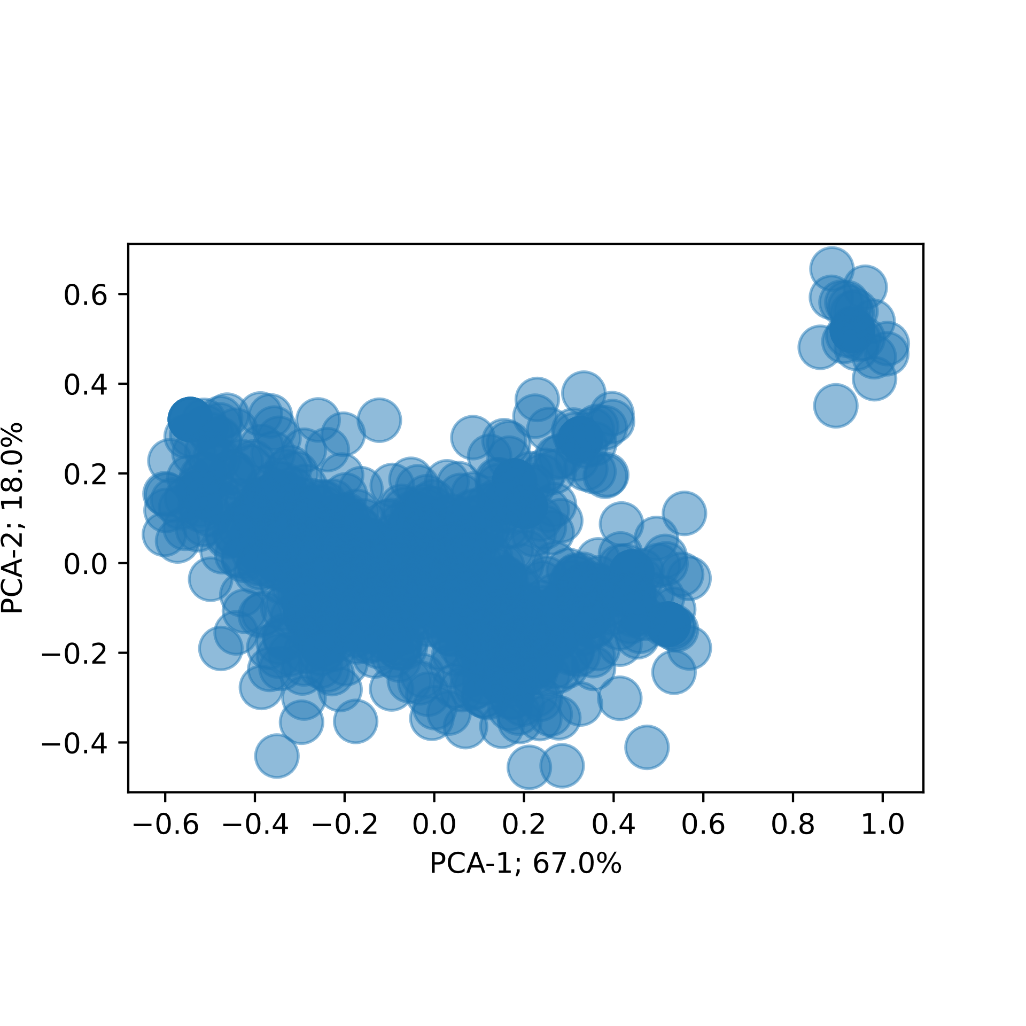
After Kmeans in feature space

Slide 13
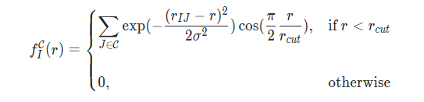
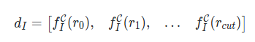
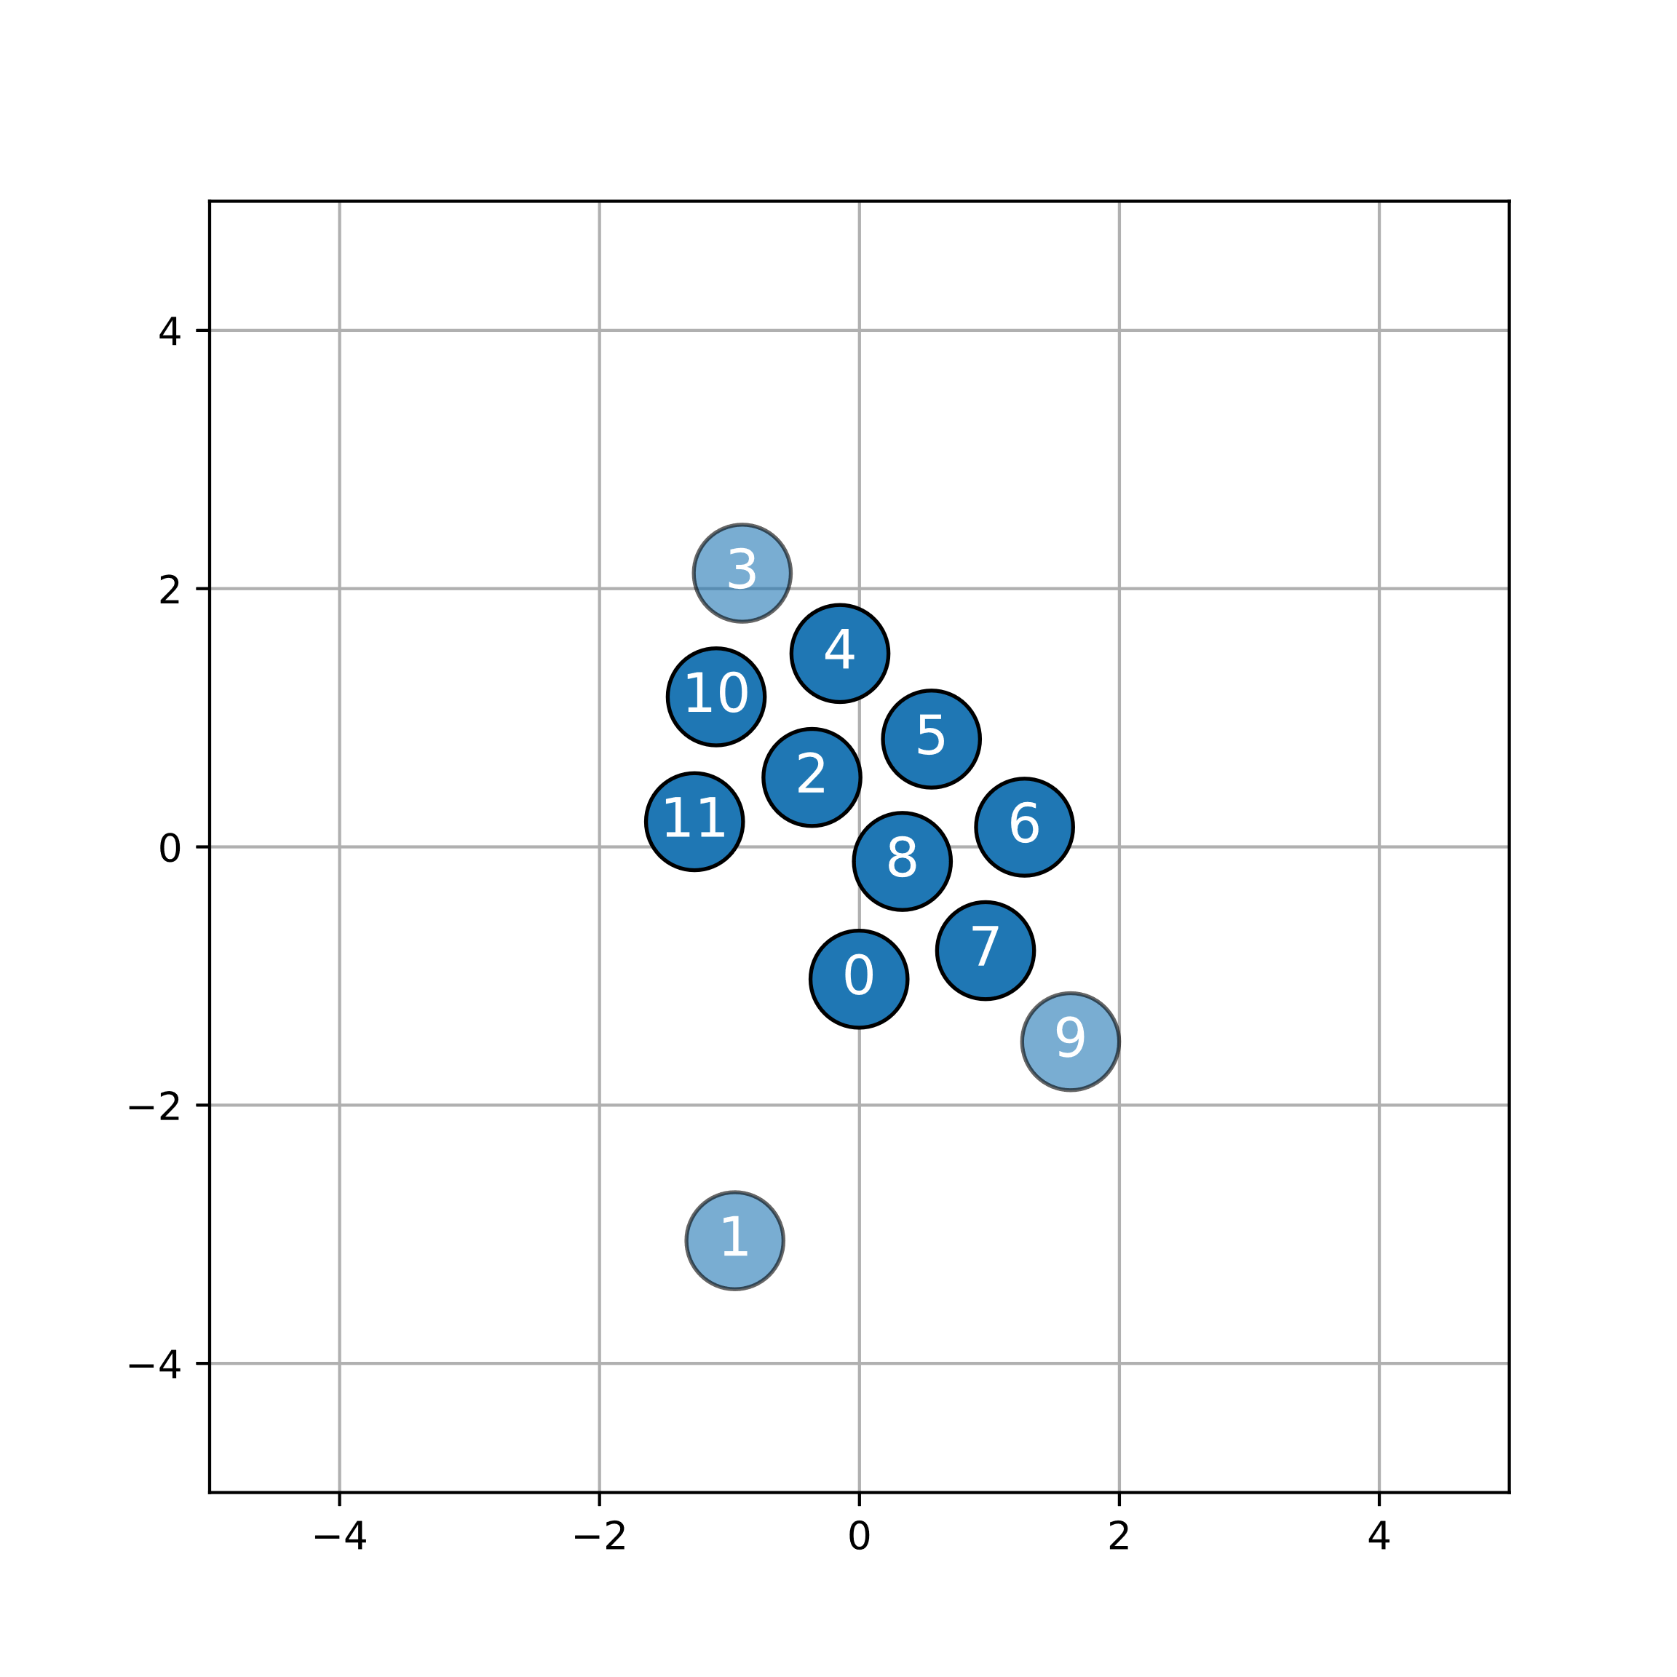
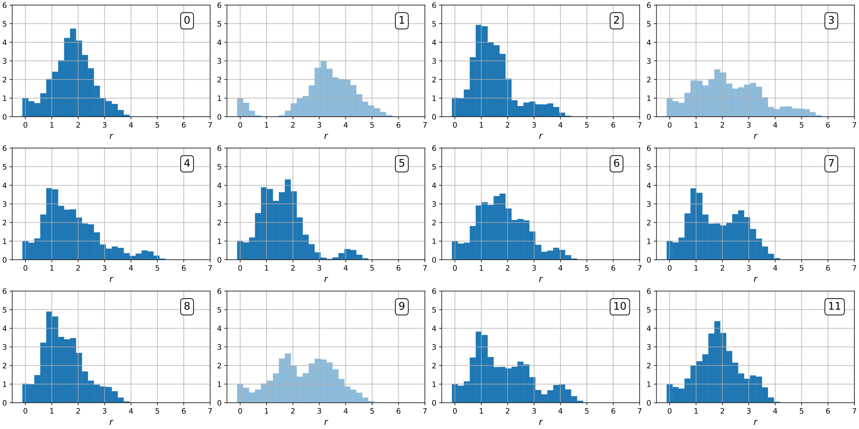
Another example: Labels already given
Atomic level descriptor & Labels provided for atoms
Case of supervised learning → Train NN
Minimize the Cross Entropy
Label: ”Positive”
Label: ”Negative”

Slide 14
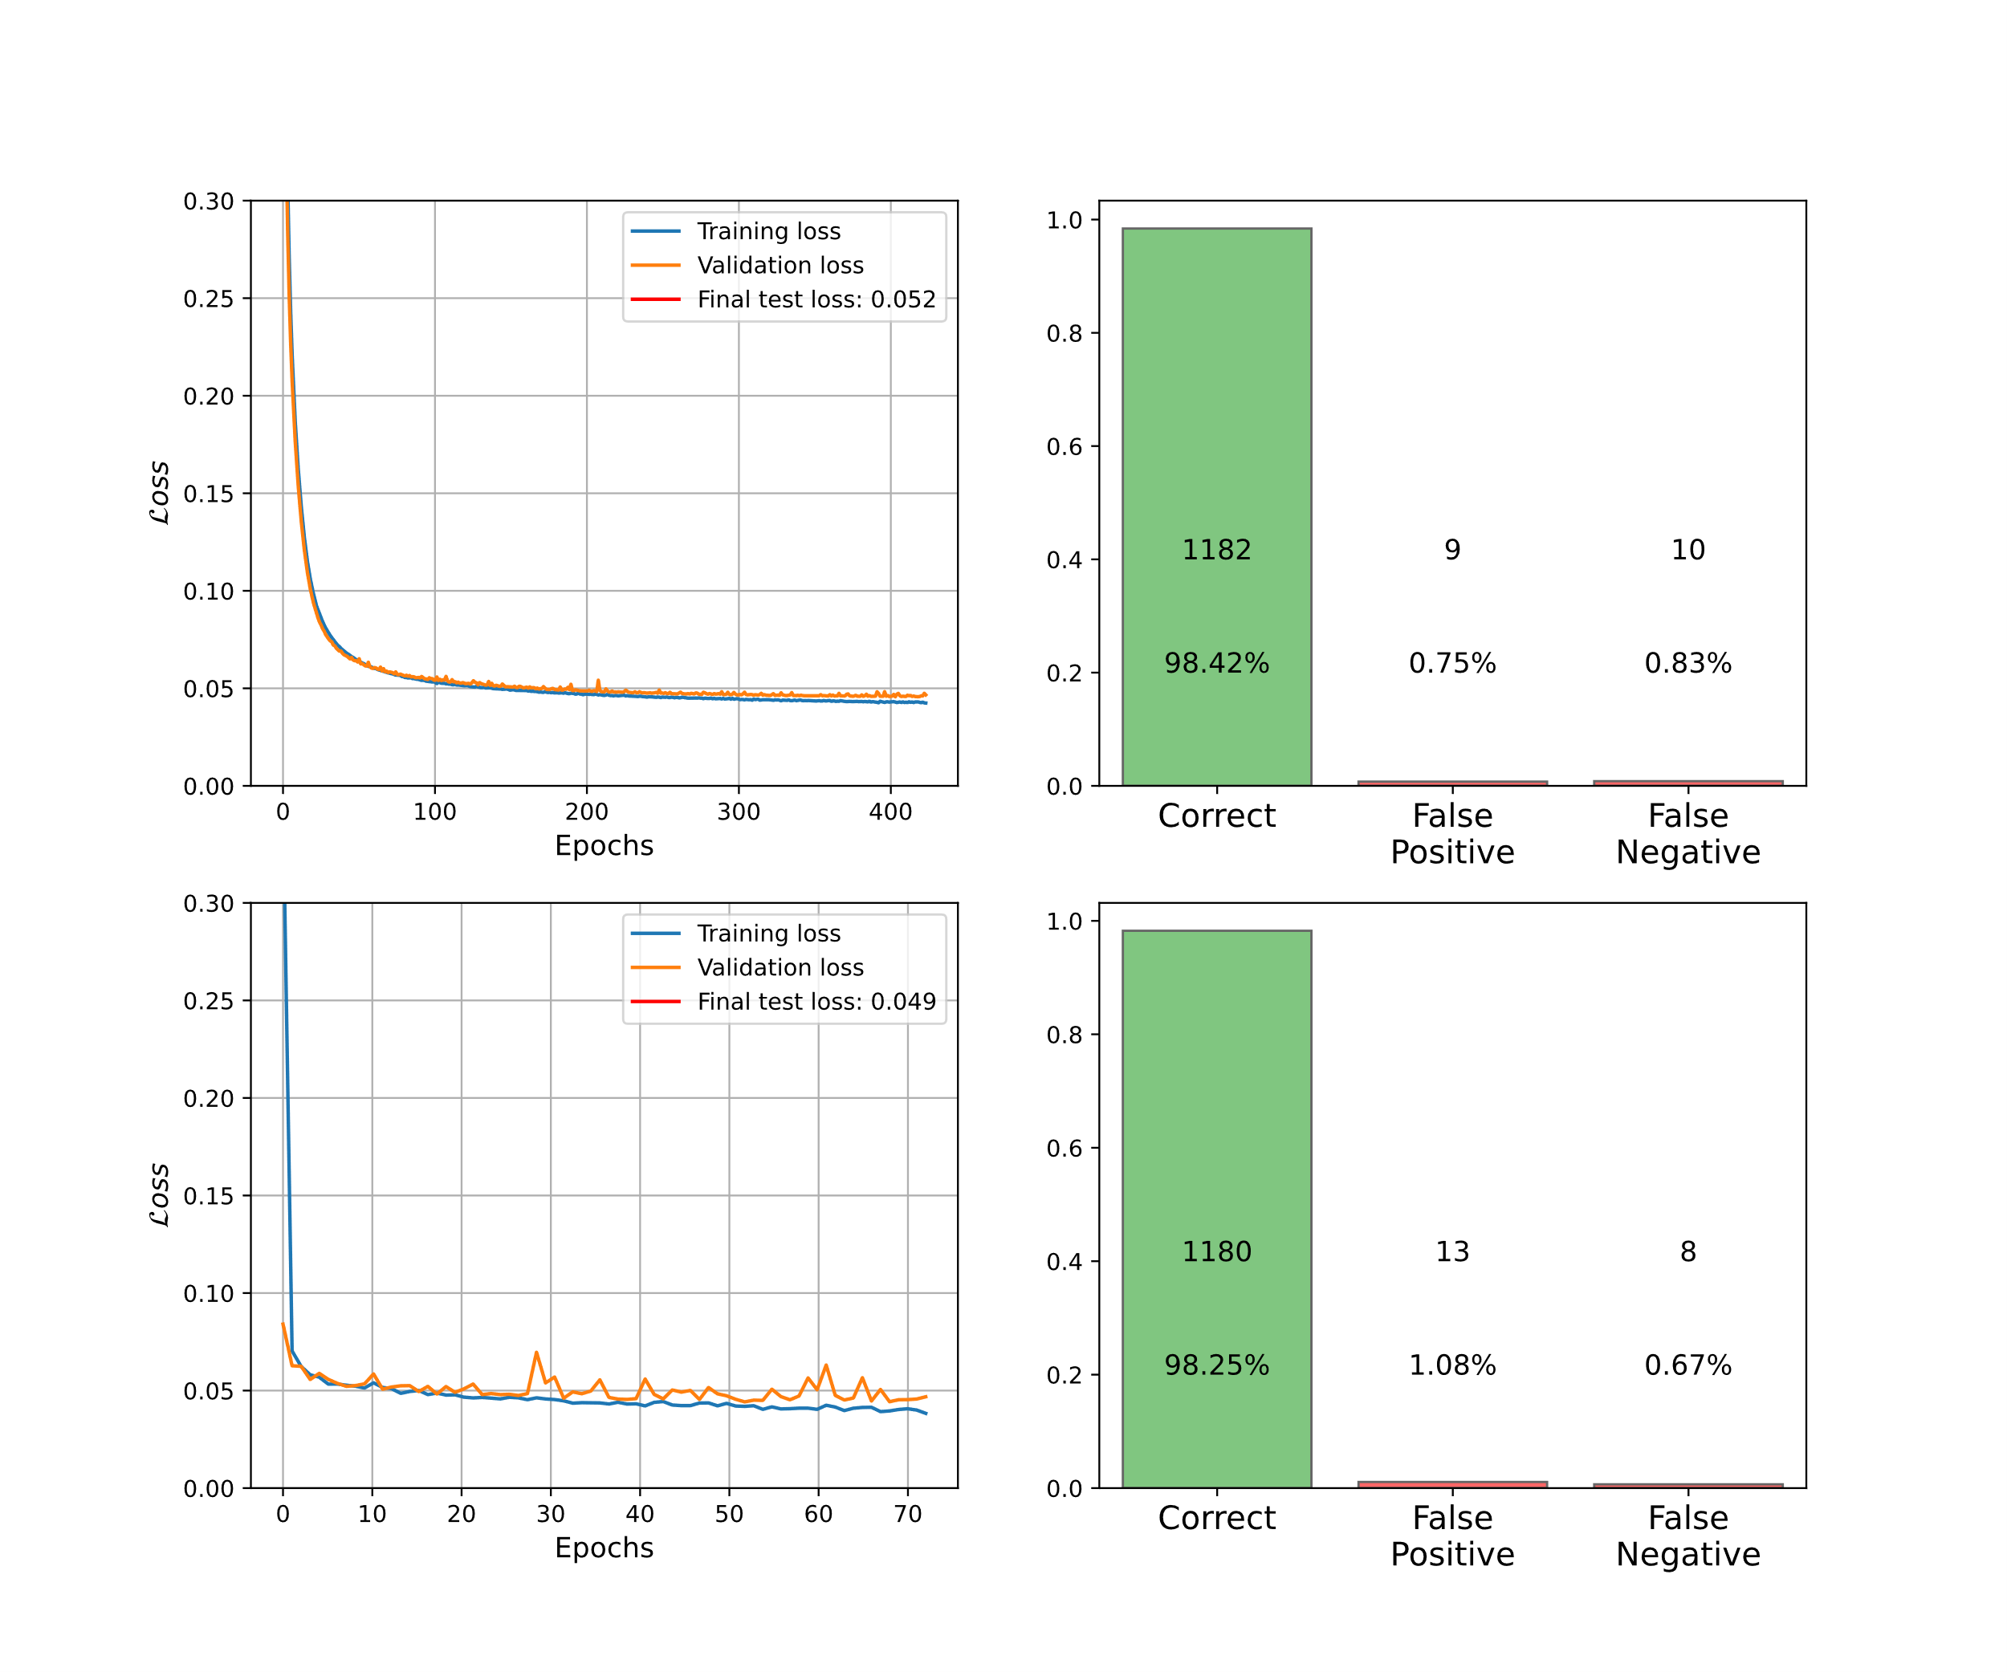
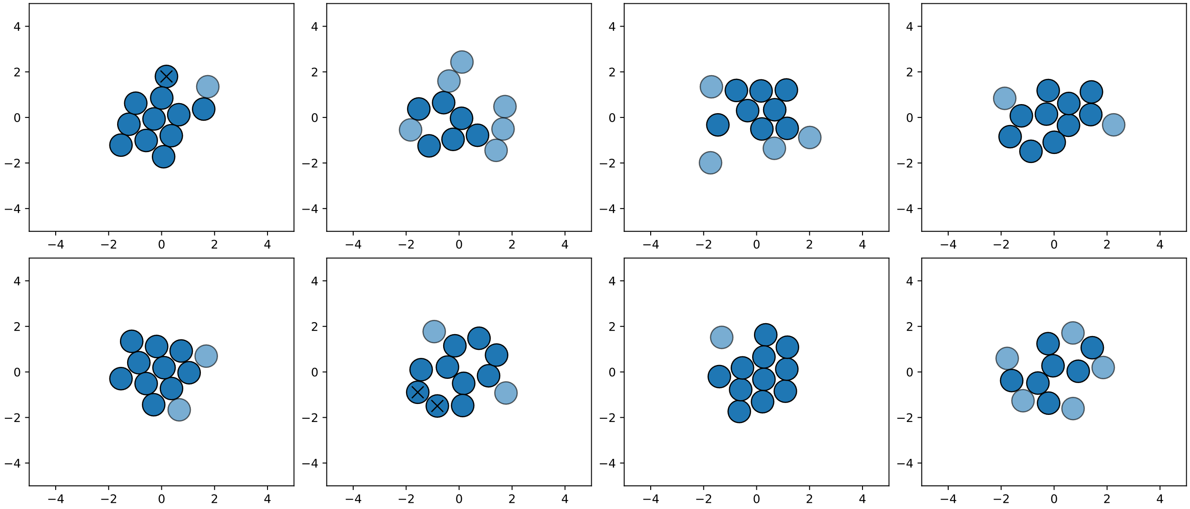
Supervised machine learning
Two NN models trained:
1-model: 1 hidden layer of 3 neurons
2-model: 6 hidden layers of 42 neurons

